Slide 1

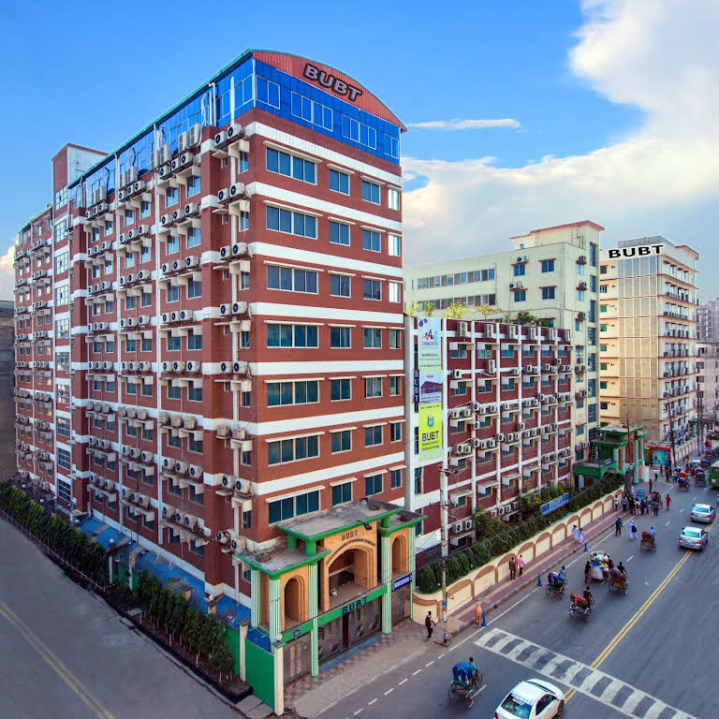
Department of Computer Science and Engineering
Course: Software Development Project
Group Name: Code Wizards
PRESENTATION on:
BUBT Student Blood Bank Management System
PRESENTATION DATE:

Slide 2


PRESENTED BY:
Md.Masudur Rahman Nirob - 22235103496
Humayra Nasrin - 22235103455
Humyra Jahan Tanha - 22235103453
Umme Fawzia - 22235103468
Neamul Hasan Bulbul - 22235103457
PRESENTED TO:
Ahmed shafkat
Lecturer , CSE
BUBT

Slide 3
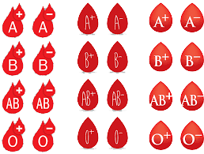
OUTLINE
1.Introduction
2.Objective
3.Motivation
4.Requirements
5.Working process
6.Diagrams
7. Tools ,Technology and Project Showcase
8. Hardware Requirements
9. Future Purpose
10. Conclusion

Slide 4

Introduction
Ladies and Gentlemen,
In a world marked by constant change and progress, we often overlook the significance of simple yet vital services that impact lives in the most profound ways. Today, we introduce you to a project that embodies the spirit of giving, community, and technology. We present the "Blood Bank Management System."

Slide 5

Objective
The objectives of the Blood Bank Management System are as follows:
To allow the probable recipients to make search
To provide an efficient donor and blood stock management functions
To improve the efficiency of blood stock management
To provide synchronized and centralized donor and blood stock database
To help raise awareness in the community about blood donation

Slide 6


Motivation
Patient Safety
Resource Conversation
Cost Efficiency
Regulatory
Compliance
Data And
Analytics
Improved
Patient
Outcomes

Slide 7
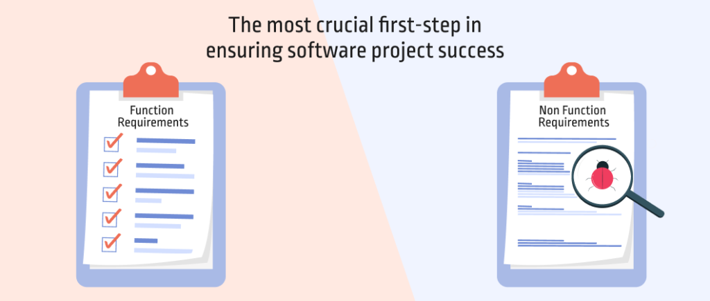


Requirements
User Registration.
Donor Information Storage.
Donor Search Functionality.
Donor Update and Deletion.
Displaying Donor List.
User Authentication.
Emergency Notifications.
Reporting and Analytics.
Security.
Scalability.
Usability.
Performance.
Availability.
Data Backup and Recovery.
Compliance with Regulations.
Integration.

Slide 8

Working Process
Donor Registration.
Data Storage.
Adding Donors.
Donor Search.
Updating Donor Information.
Deleting Donor Information.
Displaying Donor List.
Community Engagement.
Accessibility and Efficiency.
Future Expansion.

Slide 9
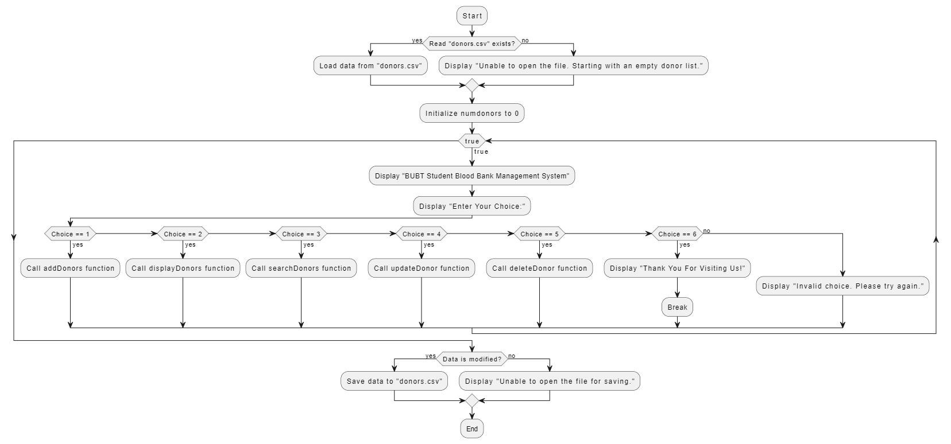
Diagrams

Slide 10
Tools ,Technology and Project Showcase
programming languages: C++
1. It includes necessary header files for input/output, data structures, and file handling.
2. The `Donor` structure is defined to store information about donors.
3. The program defines an array of `Donor` structures to store donor records and keeps track of the number of donors using the `numdonors` variable.
4. Functions like `savedonerdata`, `DonorsdataFile`, `addDonors`, `displayDonors`, `searchDonors`, `updateDonor`, and `deleteDonor` are defined to manage donor data.
5. The `main` function is the entry point of the program and provides a menu for users to perform various operations.

Slide 11
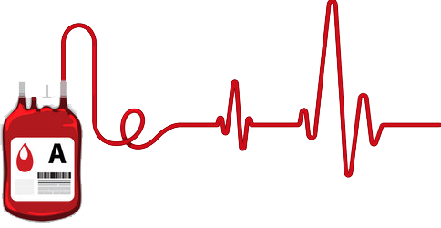
Hardware Requirements
Device: HP Elite Book 840 g3
Processor: intel® Core™ i5-6300U CPU
Ram: 8.00 GB
OS: Microsoft Windows 11 Pro N
Software Requirements
Visual Studio Code

Slide 12

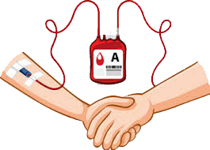
Future Purpose
Improved User Experience.
Mobile App Development.
Donor Reminders.
AI and Predictive Analytics.
Community Engagement.
Healthcare Integration.
Quality Control and Compliance.
Feedback Mechanism.
Research and Analysis.

Slide 13


Conclusion
In conclusion, the development of the Blood Bank Management System represents a significant achievement in the healthcare sector. This project aimed to streamline the operations of blood banks, making the process of blood donation, inventory management, and blood distribution more efficient, reliable, and secure. Through the development of this system, several important achievements and outcomes have been realized..

Slide 14

AND
THE END

